Slide 1
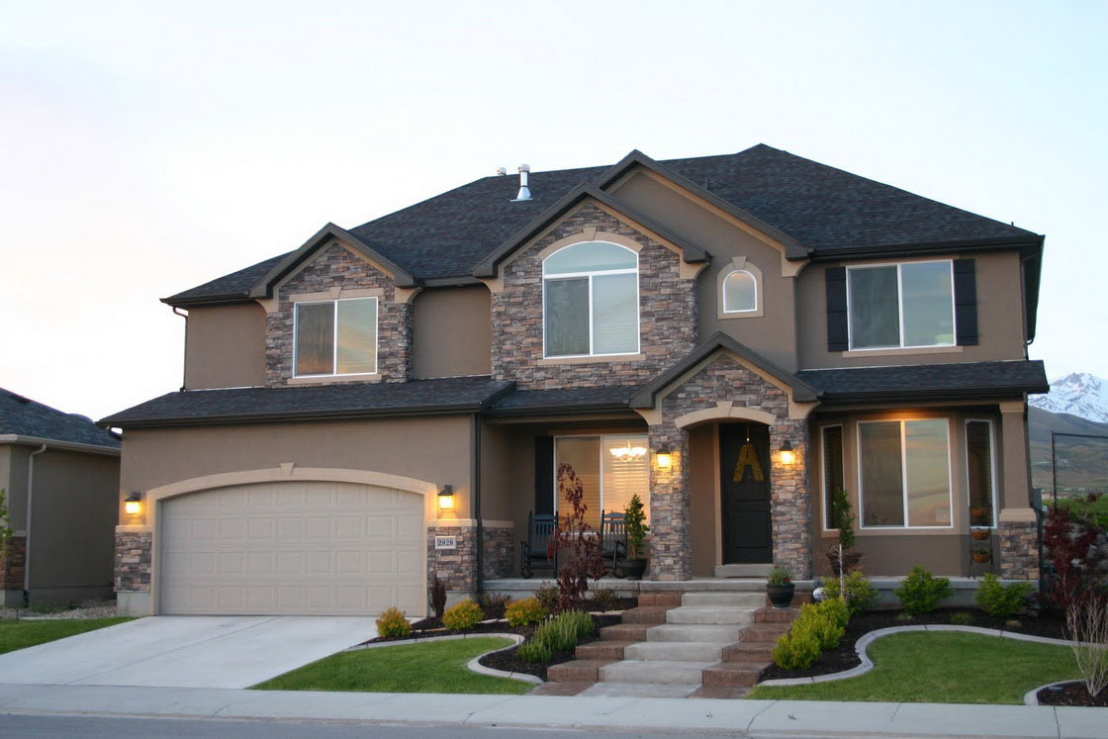
Christian L’Heureux | Charles Hsu | Bhargav Shankar | Hany Salidis | Rahul Gupta
Data Mining Research Project

Slide 2
Overview: The US Housing Market 1996-2012
Overview | Model 1 | Model 2

Slide 3
Overview: The US Housing Market Growth Rate 2012-2016
Overview | Model 1 | Model 2

Slide 4
Overview: The US Housing Market Factors
Overview | Model 1 | Model 2

Slide 5
Overview: The US Housing Market Factors
Overview | Model 1 | Model 2

Slide 6
Overview: Data, Hypothesis
Housing market activity contributes about five percent to the US gross domestic product. As Baby Boomer generation reaches its retirement, the cumulative effect of downsizing their lifestyles may have a large effect on housing market prices.
Data:
Response Variable: Median Housing Prices between 1996 – 2016
Independent Variables: Growth Rate, Population, Population Change %, Median Age, % over 65 (2014), % over 65 (2015), median income, in civilian labor force, Persons per sq mi
Overview |

Slide 7
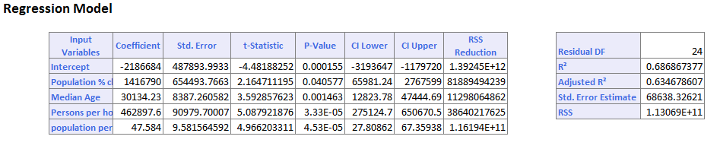
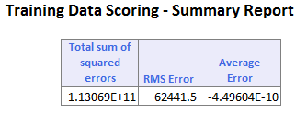
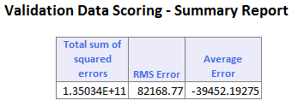
Median Home Value
Model 1: Multiple Linear Regression
Median Home Value = -2186684 + 1416790 Population % Change + 30134.23 Median age + 462897.6 Persons per Household + 47.584 Persons per sq mi
Overview | Model 1 |

Slide 8
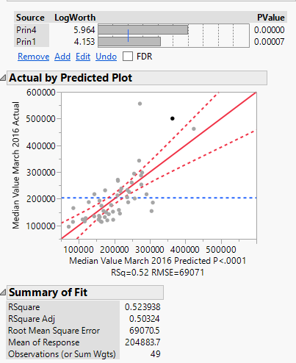
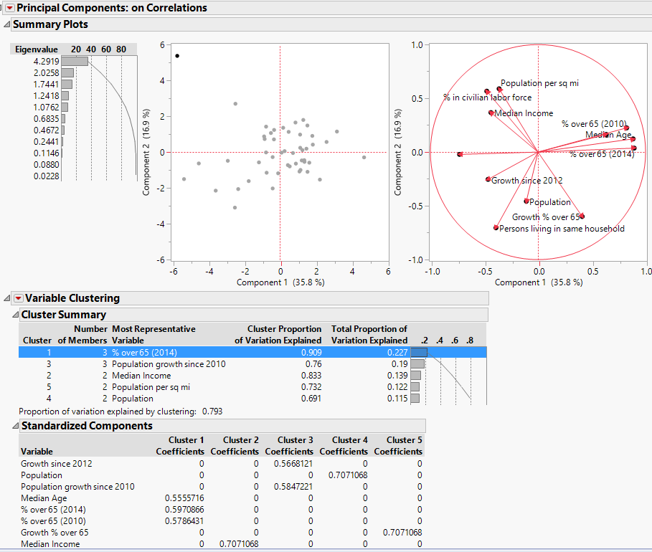
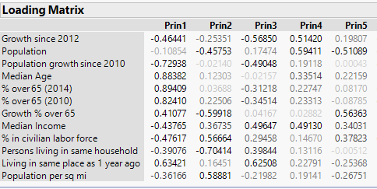
Median Home Value
Model 2: PCA and MLR
Overview | Model 1 | Model 2

Slide 9
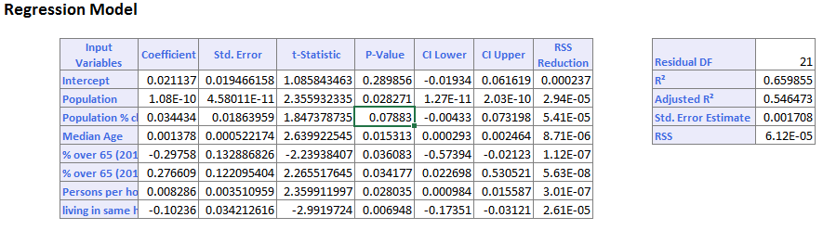
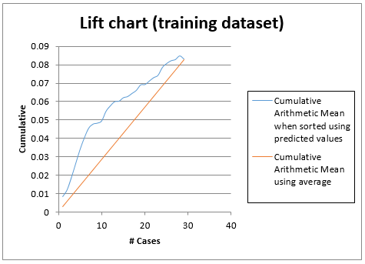
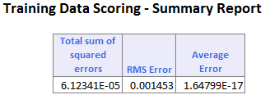
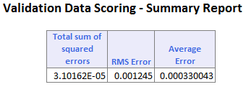
Growth Rate 2012-2016
Model 3: MLR
Overview | Model 1 | Model 2 | Model 3 |

Slide 10
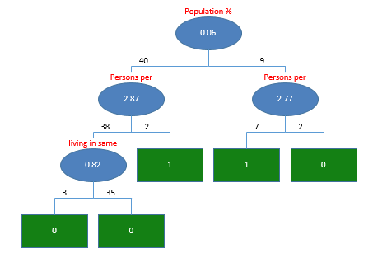
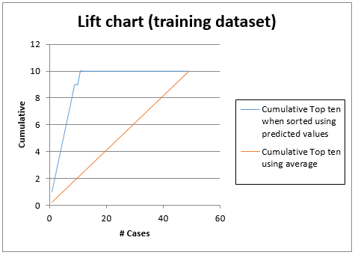
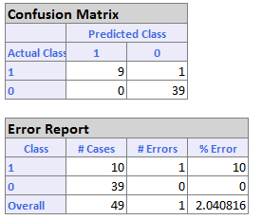
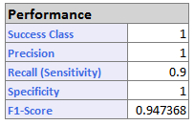
Growth Rate 2012-2016
Model 4: Classification Tree to Predict Top 10
Overview | Model 1 | Model 2 | Model 3 | Model 4 |

Slide 11
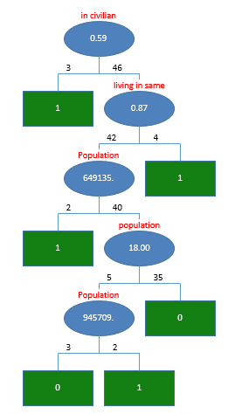
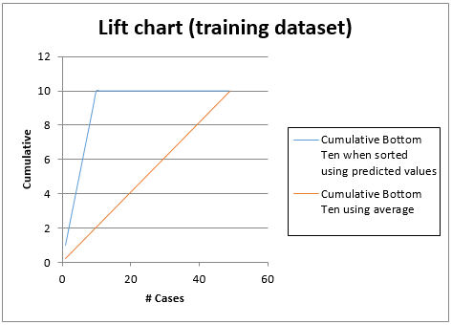
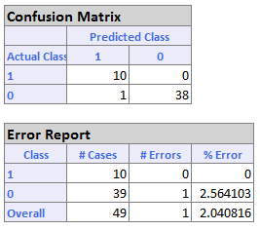
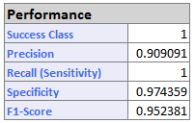
Growth Rate 2012-2016
Model 5: Classification Tree to Predict Bottom 10
Overview | Model 1 | Model 2 | Model 3 | Model 4 | Model 5 |

Slide 12
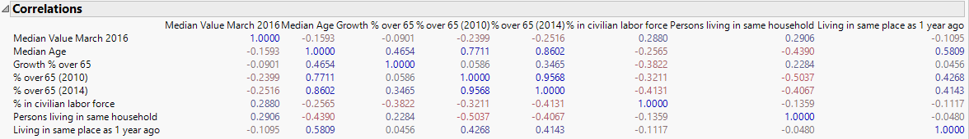
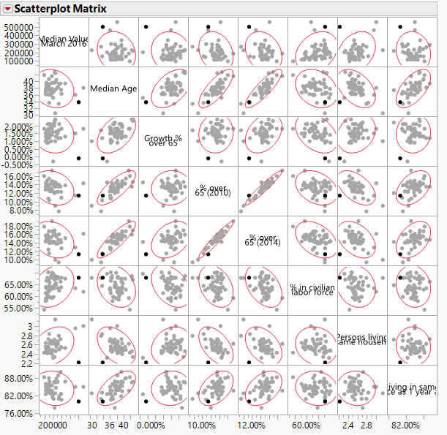
Insights
Train of correlation: High growth in % over 65 -> Median age (0.465, p 0.001), Median Age -> Living in same house as 1 year ago (0.584, p < 0)
Living in same house as 1 year ago -> Growth since 2012 (-0.616, p <0) Possible explanation: States with a higher proportion of baby boomers have been slower to recover from the housing crash, thus they have stayed in their homes longer than those younger, more transient areas.
Overview | Model 1 | Model 2 | Model 3 | Model 4 | Model 5 | Insights |

Slide 13
Conclusions
As Baby Boomers age, they are having a negative effect on median home values
However, we are yet to see much of this effect due to the slow recovery from the housing crash
Correlation is not causation, models show relevant factors but not causality
Improvements
Expand data set to zip code specificity
(Limited by demographic information available at this level)
Correlation is not causation, models show relevant factors but not causality
Limit study to states with high % of baby boomers (West Virginia)

Slide 14
References
Zillow Data API
http://www.zillow.com/research/data/
US Census Bureau
http://www.census.gov/quickfacts/table/POP060210/00,22
USA.com
http://www.usa.com/rank/us--median-age--state-rank.htm

